Slide 1
DEPARTMENT OF ADMINISTRATION preserving the past, serving people today, planning for tomorrow
2022-2023 AGENCY REQUEST
CIP Budget Overview Presentation
September 27, 2020
LAURA E. FREED, Director
Ron Cothran, Deputy Administrator
Notes:
Good afternoon, my name is Ron Cothran and I am the Deputy Administrator and I will be presenting the CIP projects for the Buildings and Grounds Section and the Marlette Lake Water System.

Slide 2
DEPARTMENT PRIORITY
Support, promote and enhance
government efficiency and innovation
to provide Nevadans
with quality access to government services

Slide 3
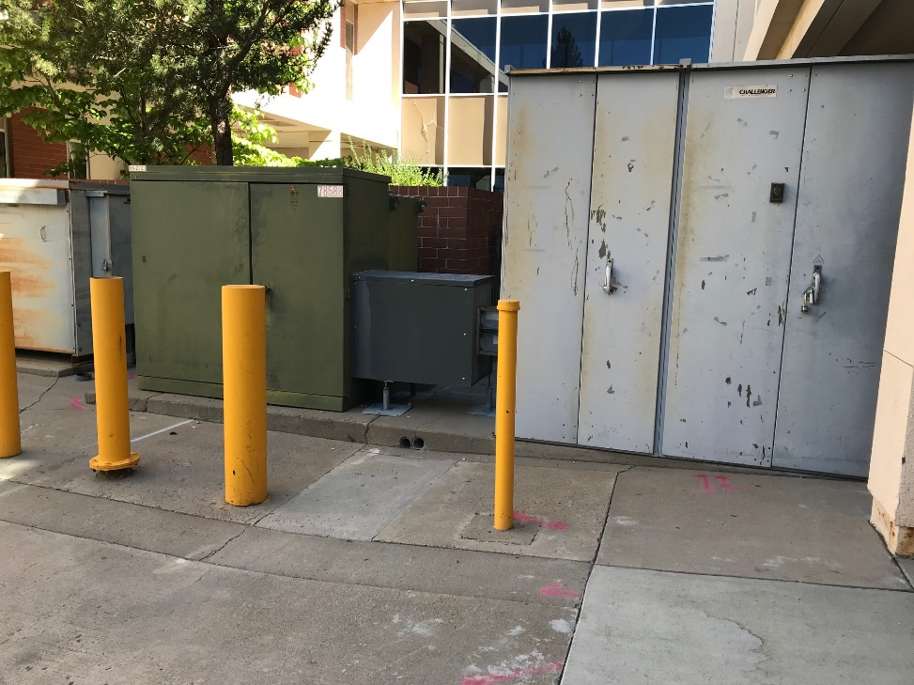
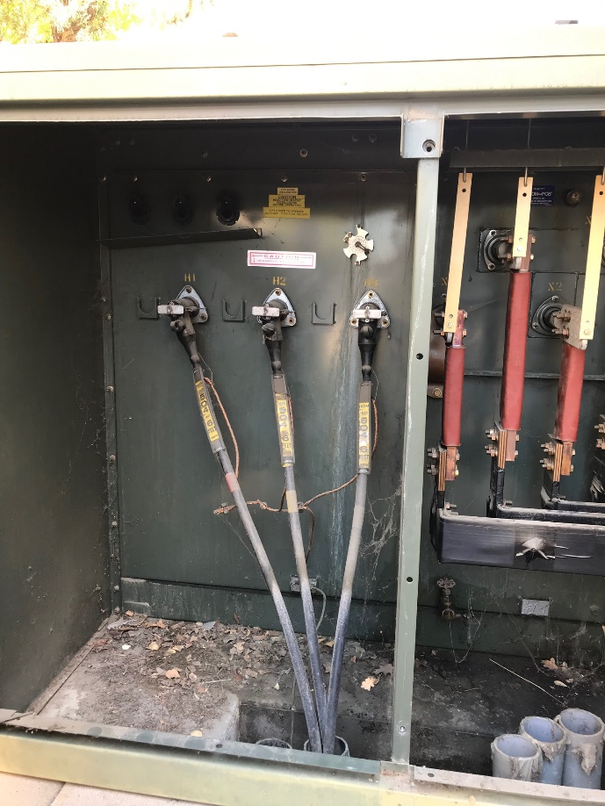
Replace Electrical Service Carson City DMV
Priority #9 - $746,665 *100% Highway Funds
Replace utility transformer & main switchboard at the Carson City Department of Motor Vehicles
Notes:
This project is priority #9 and is to replace the Electrical Service for the Carson City DMV and is *100% Highway Funded.
This project will upgrade the electrical service entrance, underground feeder,
utility transformer and main switchboard.
The utility transformer and main switchboard are known to fail and is subject to damage.
The existing equipment is approximately 30 years old and has reached the end of its useful life and needs to be replaced.

Slide 4
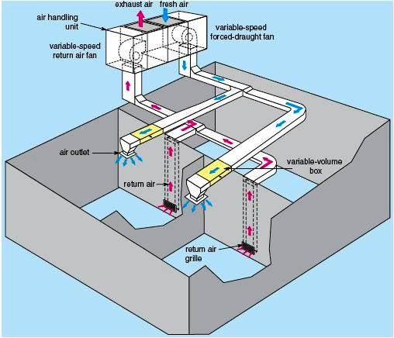
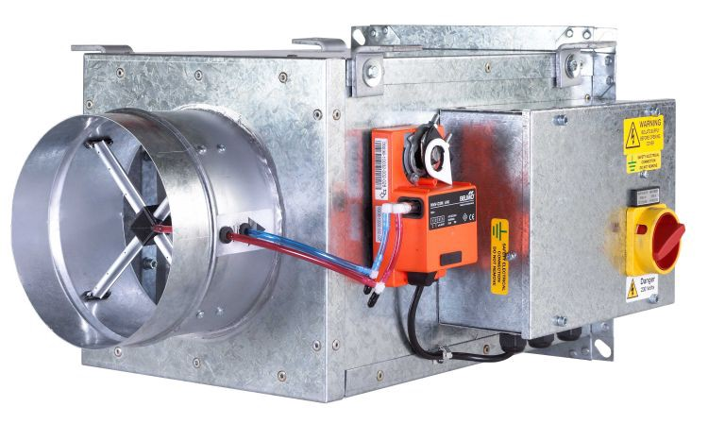
VAV Terminal Units Replacement Flamingo DMV
Priority 10 - $1,014,828 *100% Highway Funds
Notes:
This is priority #10 and will replace 46 VAV terminal units at the Flamingo DMV and is *100% Highway Funded.
Only the VAV’s need to be replaced as the rest of the mechanical equipment was replaced in 1995.
Typically with a commercial building, a VAV within a HVAC system has individual controls for smaller zones.
When a VAV stops working the dampers can remain closed, or in the open position and cannot be adjusted.
Additionally, sometimes the fans stop working and they cannot be controlled by a Direct Digital Control also known as (DDC).
Currently, the VAVs are beyond their useful life expectancy and have begun to fail.

Slide 5
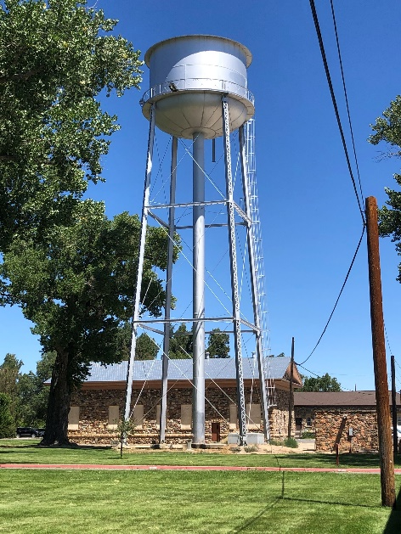
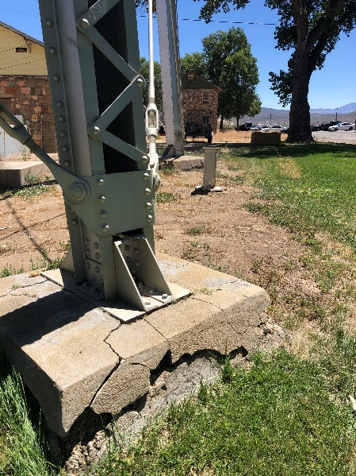
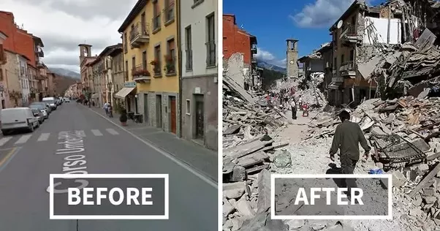
Seismic Retrofit
Priority #11 - Heroes building $1,544,163 / #27 - $2,887,738 Armory Building / #35 - $998,671 Stewart Water Tower
The Heroes, Armory and the Stewart Water Tower were built in the early 1900’s
This project reinforce the buildings and water tower
This project provides valuable office space within the Capitol Complex and upgrades for current seismic code compliance
Notes:
This is priority #11, 27 and 35 and proposes structural reinforcement and building rehab for the Heroes, Armory and the Stewart water tower.
These structures were constructed in the early 1900s and they are not structurally sound.
If a major seismic event were to happen,
the buildings and water tower would encounter major damage and could have complete failure.
This project would provide for safer buildings and a safer water tower,
and will preserve the history for Nevadans.

Slide 6
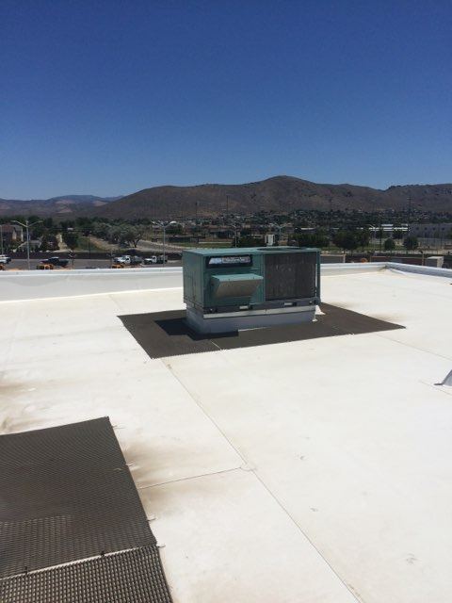
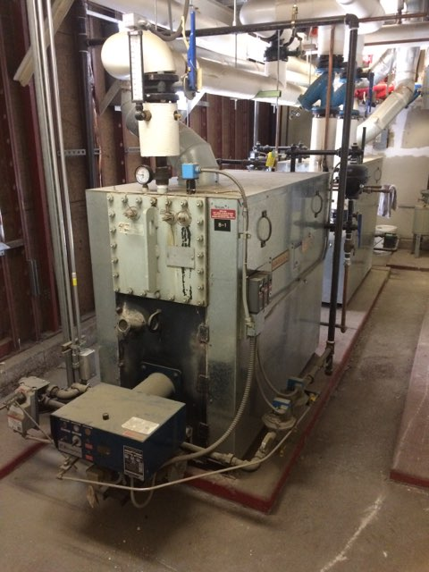
HVAC Renovation (19-P05) Carson City, DMV
Priority #12 - $5,321,115 *100% Highway Funded
These systems are over 20-years old and are beyond their useful life expectancy
The current systems are all different and are not cohesive
Notes:
This project is priority #12 and proposes HVAC Renovations at the Carson City DMV and is *100% Highway Funded.
The Carson City DMV has numerous types of heating and air conditioning systems to include package units, boilers, chillers, and cooling towers. ALL systems are older than 20 years and beyond their useful life expectancy and are failing.
Once these systems are replaced, they will be energy efficient and can be managed with a DDC.
The DDC will enable us to remotely control temperature adjustments,
and will notify us when there is an alarm or system problem.
Allowing B&G to fix system problems before the building occupants are aware there is an issue.
This project assists the State in achieving the goals set out in Senate Bill 254 and the Governor’s executive order that states, "The primary U.S. Climate goal is to reduce greenhouse gas emissions by at least 26-28 percent below 2005 levels by 2025."

Slide 7
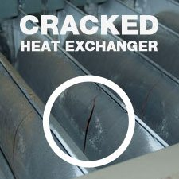
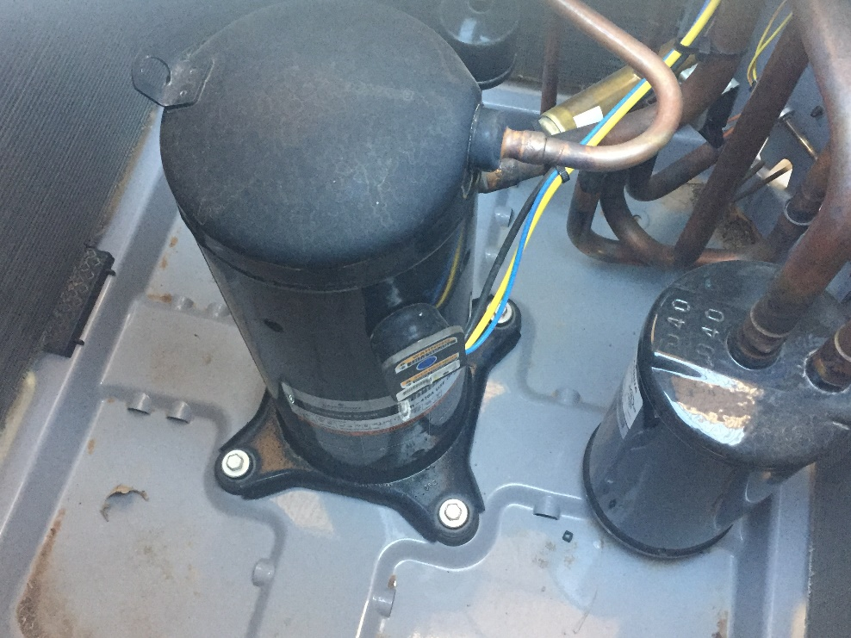
HVAC Renovations
The manufacturer warranty expired at 20-years on the heat exchangers
Approximately, 1000 people die every year in the US from CO poisoning.
R22 refrigerant phased out / no longer EPA compliant and no longer sold in the U.S. as January 2020
Notes:
The manufacturer’s warranty on heat exchangers is 20 years.
Please look at the picture on the left. The heat exchanger is a thin gauged steel that expands and contracts when the system heats up and cools down.
With expansion and contraction over time this can cause the steel to weaken and crack. When the heat exchanger has a crack, it will leak Carbon Monoxide (CO) into the occupied space. CO is a gas which can cause (headaches, nausea, dizziness, breathlessness, and death. Approximately, 1000 people die every year in the US from CO poisoning.
The picture on the right shows a typical compressor that uses R22 refrigerant.
R22 refrigerant is no longer EPA compliant and no longer sold in the US as of January 2020.

Slide 8
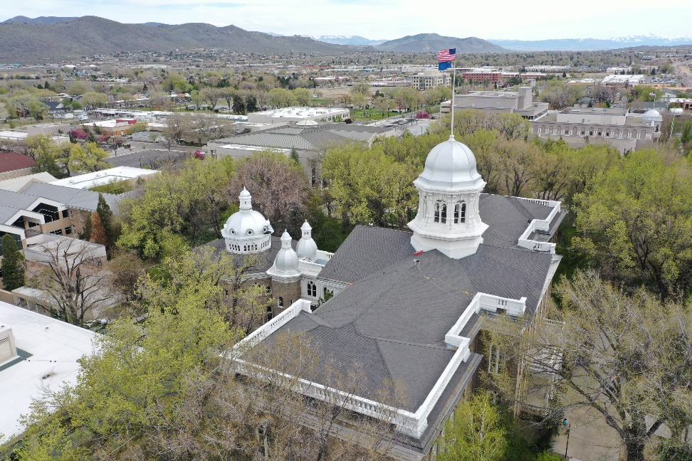
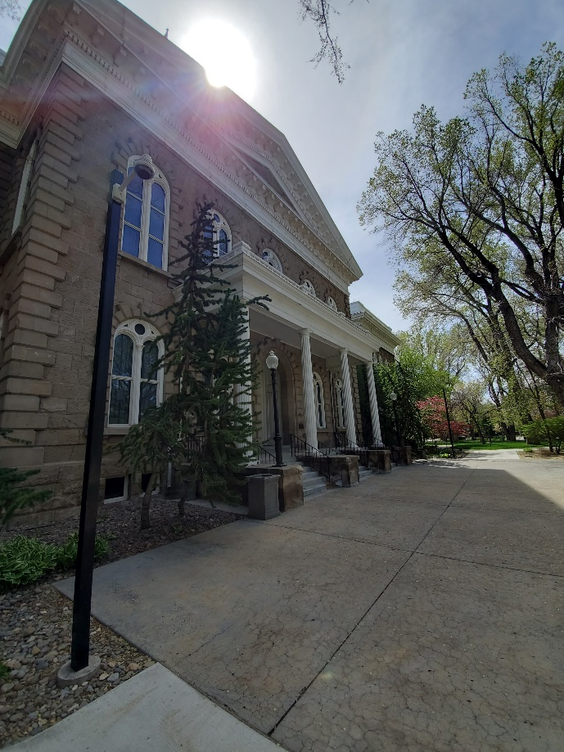
Exterior Renovation Capitol
Priority #13 - $5,223,908
Notes:
This project is priority #13 and proposes to restore the Capitol domes that are cracking and are leaking. The last restoration of the domes was in 1993.
The domes will be repaired and painted to prevent further deterioration.
The fascia, soffits, windows, doors and the sandstone mortar joints have not been repaired and/or painted since the Capitol renovation in 1979.
The scope of this project will perform an exterior renovation at the Capitol and Annex building.

Slide 9
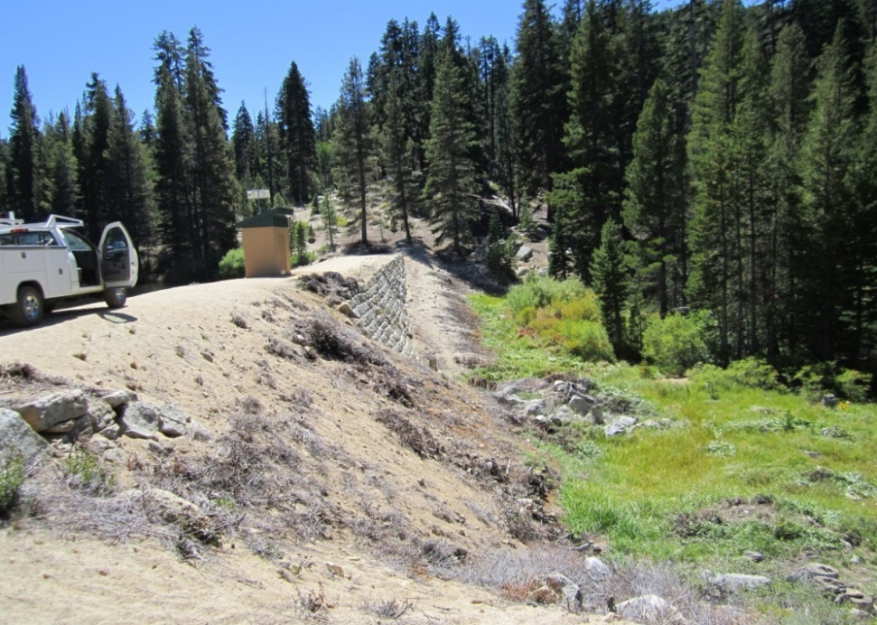
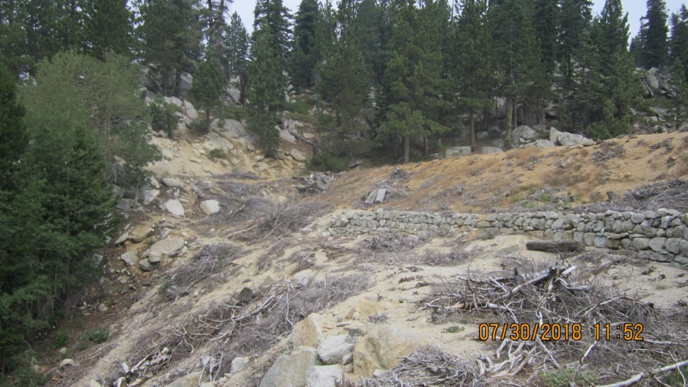
Hobart Reservoir Dam Repairs
Priority #14 - $2,728,964 State Funds *$10,000,000 Grant Funds
Hobart Dam is a significant safety hazard and is not complaint with NRS 535 Dam Safety
Perform structural and functional upgrades of the Hobart Dam
Notes:
This project is priority #14 and proposes to repair the Hobart Dam as it is a significant safety hazard and is not in compliance with NRS 535 Dam Safety.
This CIP project will provide schematic design to rehab and will perform structural and function upgrades of the Hobart Dam.
The scope of work includes an assessment of existing conditions, regrading,
placement of riprap, spillway repair, and discharge piping and valve repairs.
Failure of this dam would not only interrupt water supply to Carson City and Storey County but would potentially damage property and endanger lives.

Slide 10
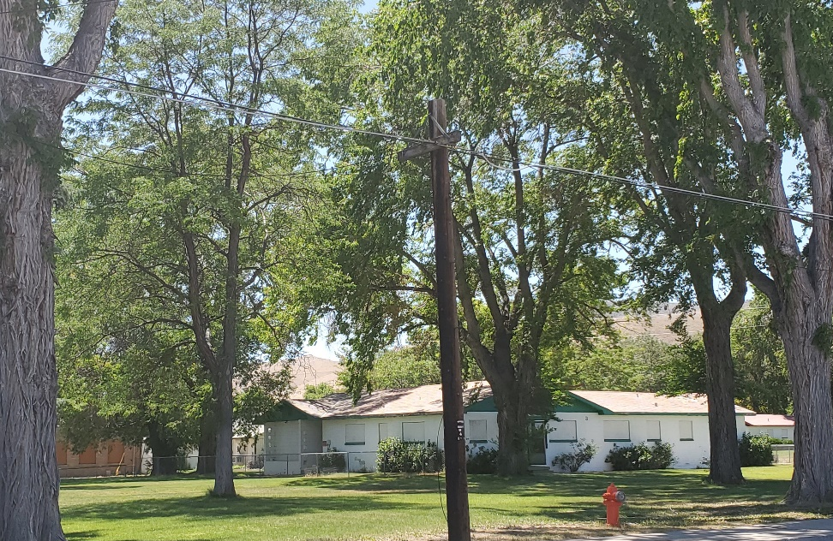
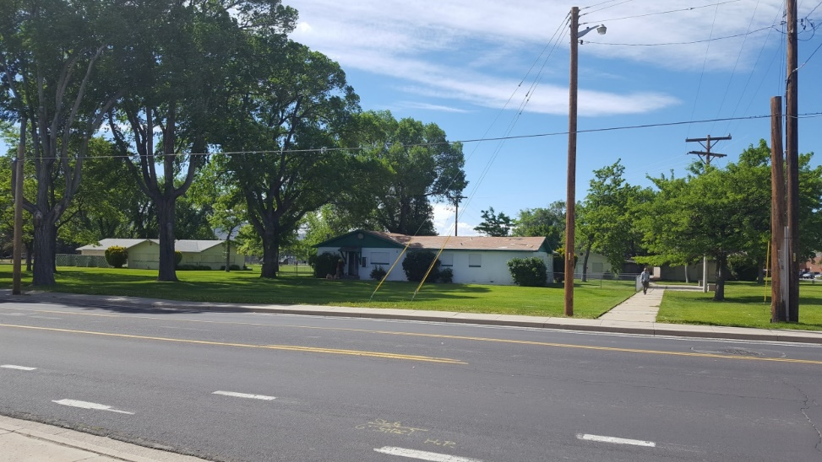
Demolition of Cottages
Priority #15 - $1,381,237
Maintaining the grounds at this location costs the State approximate $10,000 per month
Achieve the goals set out in Senate Bill 254 and the Governor’s executive order to reduce greenhouse gas emissions
These buildings within the Capitol Complex are boarded up and are not safe for human occupancy
Building new structures would cost less as opposed to remodeling
Notes:
This project is priority #15 and proposes to demo the cottages.
These 15 cottages were constructed in the early 1960s.
These buildings are considered to be located within the Capital Complex of Carson City and are an eye sore with boarded windows and dilapidated siding and doors. The exteriors and grounds are maintained by B&G at a cost approximately $10,000.00 per month in summer to water the grass.
B&G would like to demo these buildings and install xeriscape.
Capitol Police resources are continually needed in an attempt to keep the homeless off of the property.
In order to make these buildings habitable, it would take a complete renovation, to include electrical, plumbing, fire suppression, asbestos abatement and bringing the buildings up to current building code. The cost to renovate would be more costly than to completely demolish and re-build new buildings.
This project assists the State in achieving the goals set out in Senate Bill 254 and the Governor’s executive order to reduce energy consumption.

Slide 11
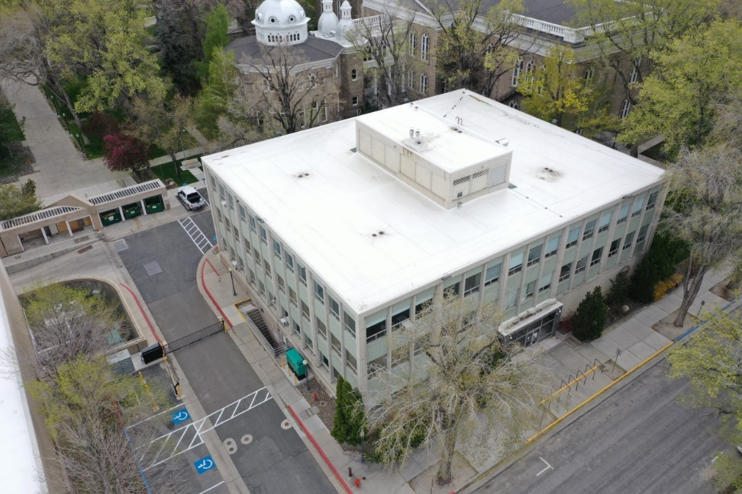
Blasdel Upgrade HVAC, Electrical and Windows
Priority #16 - $1,694,101
The building was constructed in 1957 63 years old
Single pane windows are not energy efficient and will hinder the new mechanical system from working correctly
The HVAC, electrical and windows are beyond their useful life expectancy
HVAC 20-year life expectancy
Electrical 50-year life expectancy
Notes:
This project is priority #16
The Blasdel building was constructed in 1957.
The radiant heating system is on the exterior walls and is unable to heat the interior cubicles.
Due to this, employees that work in the interior cubicle spaces will bring in space heaters.
The electrical cannot keep up with the demands of today’s technology to include space heaters, computers, printers, coffee makers, etc.
There are 20 amp breakers in this building and the max capacity of the 20 amp breakers is 16 amps or 80%. The building occupants consistently overload the circuits and trip breakers.
When a breaker is tripped it is because there is too much current draw on the system which produces heat through the wires.
If the breaker doesn’t trip properly it will cause the wire to overheat and can catch on fire.
This building’s electrical system has surpassed its life expectancy of 50 years and needs to be replaced. The outdated radiant heating system is beyond its useful life and is rusted and many of the valves are broken. This project proposes to install a more conventional forced air heating and air-conditioned system.
In order for this new system to be effective new windows will also need to be installed.
The windows leak air, are original and are single pane.
This project assists the State in achieving the goals set out in Senate Bill 254 and the Governor’s executive order to reduce energy consumption.

Slide 12
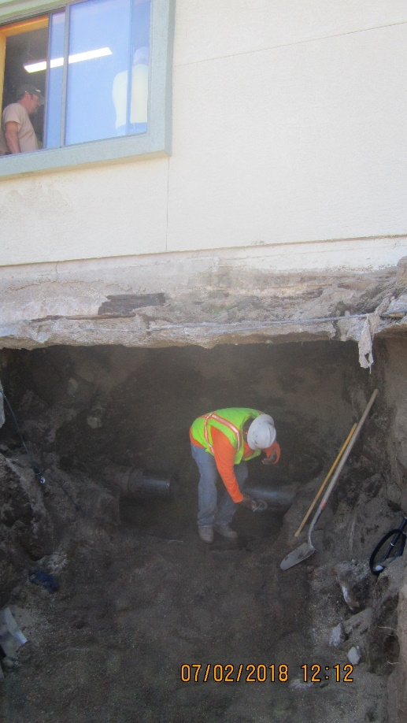
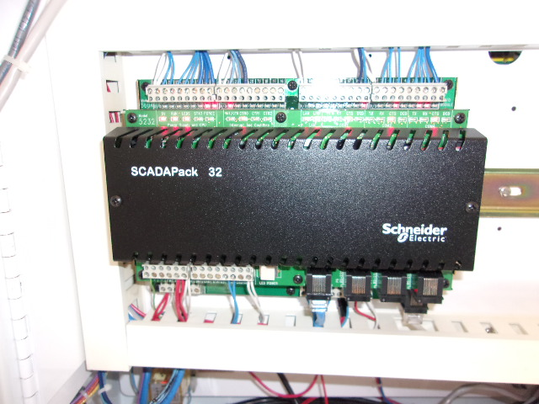
Monitor and Controls at Diversion Dam
Priority #17 - $815,268
Needs 72 more monitoring set point locations to ensure the safety and proper operations of the system
The controls are outdated, and Marlette cannot get parts
The pipe was installed in 1877
Notes:
The Marlette Lake Water System monitors water levels on
storage tanks, valves and water flow rates using a SCADA system.
I would like to tell you a story of how important a SCADA system is…
The pipe in this story was installed in 1877.
In 2018 the Marlette team got an alarm from the SCADA system on their cell phones that there was 750 psi water flowing through the pipe. Normal water flows are at 680 psi. Because there was an additional 70 psi flowing through the pipe,
the Marlette team knew there must be a break in the line.
The Marlette team had the water off within 9 minutes.
The only way they could do that and to know there was a problem is by having a SCADA system.
The break happened to be under private owner’s home.
This owner thought there was an earthquake.
The home started to rumble, the carpet and flooring started to lift from the water and mud.
Without a SCADA system the owner of the home could have died.
Currently, the SCADA system is outdated,
and we cannot get replacement parts and we cannot add to the system.
We are in need of adding 72 more monitoring set points.
This CIP project will upgrade the SCADA system and provide for the needed additional 72 set points.

Slide 13
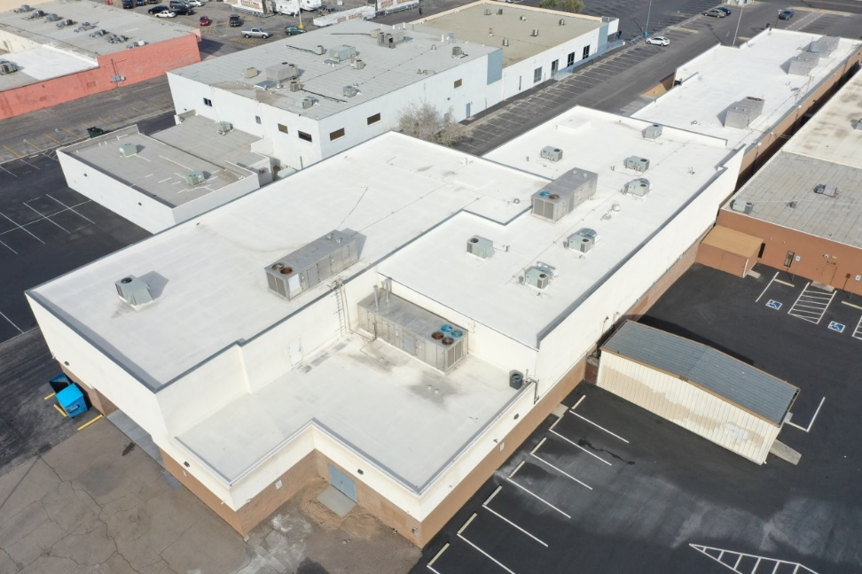
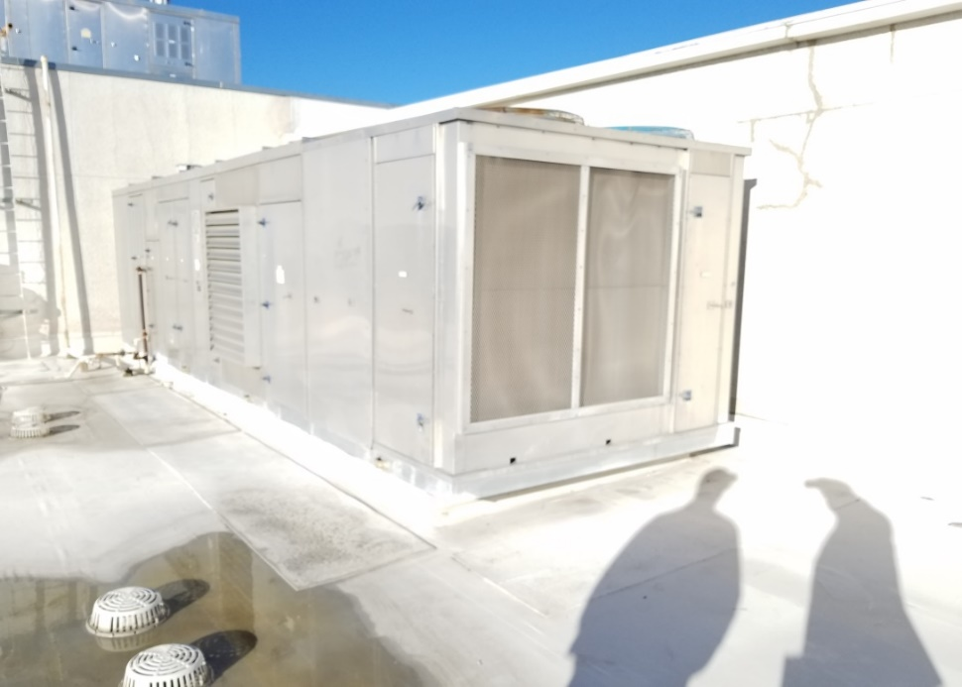
Belrose Mechanical Equipment Replacement
Priority #18 - $2,290,717
This project will replace the 6 multizone HVAC units located at the Belrose Building in Las Vegas
If a multizone system stops working, part of the building will be uninhabitable
The system is 23 years old and has reached the end of its useful life expectancy
These units use R-22 refrigerant, which is no longer available in the United States as of January 2020
Notes:
This project is priority #18.
This is a 41,000 square foot building.
The building has two types of rooftop heating and air conditioning, the smaller units are commonly known as packaged units and the larger units are known as multizone units.
The refrigerant in the multizone units is R22 and as of January 2020 is no longer manufactured in the United States.
These units have had numerous compressor failures causing the air conditioning to stop working.
In Las Vegas, with extreme heat a compressor failure can render parts of the building to be uninhabitable.
Changing these multi zone units will help the state achieve the goal set out in Senate bill 254 and the Governor's executive order to reduce energy consumption.

Slide 14
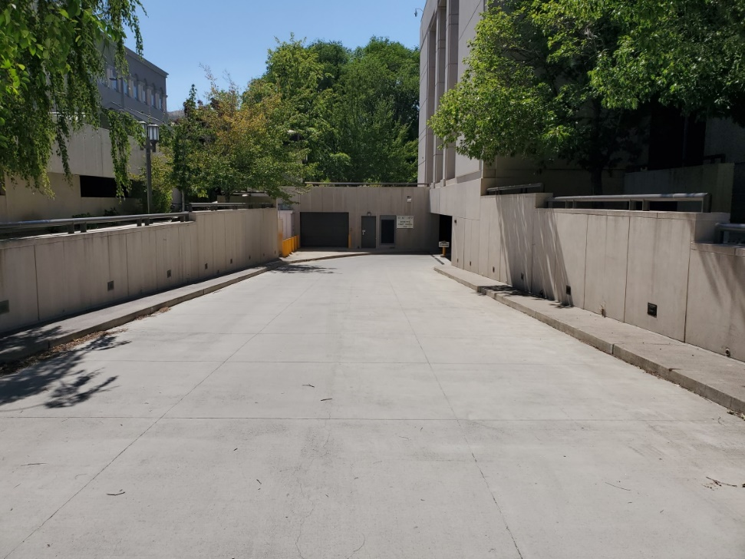
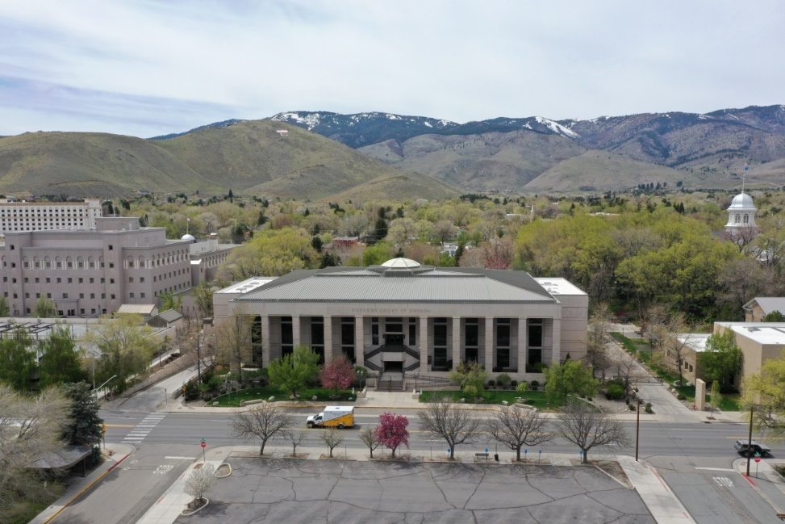
Supreme Court Driveway Snow Melt System
Priority #19 - $451,912
Driveway electric heat trace failure
10-year life expectancy
Ice and snow hazard
Current boiler was built to install a hydronic system
Hydronic systems have a 20-year life expectancy
Notes:
This project is priority #19
The Supreme Court Driveway Snow Melt System currently has electric heat trace that has failed. The Heat trace has met its 10-year life expectancy.
During the winter months the ice and snow builds up on the driveway and without a snow and ice melt system the driveway can be slick and can cause an accident.
This project proposes installing a new 20-year hydronic system that will work in conjunction with the new boiler that was installed in 2020.

Slide 15
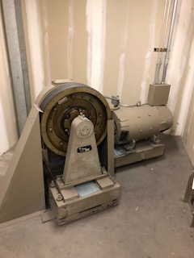
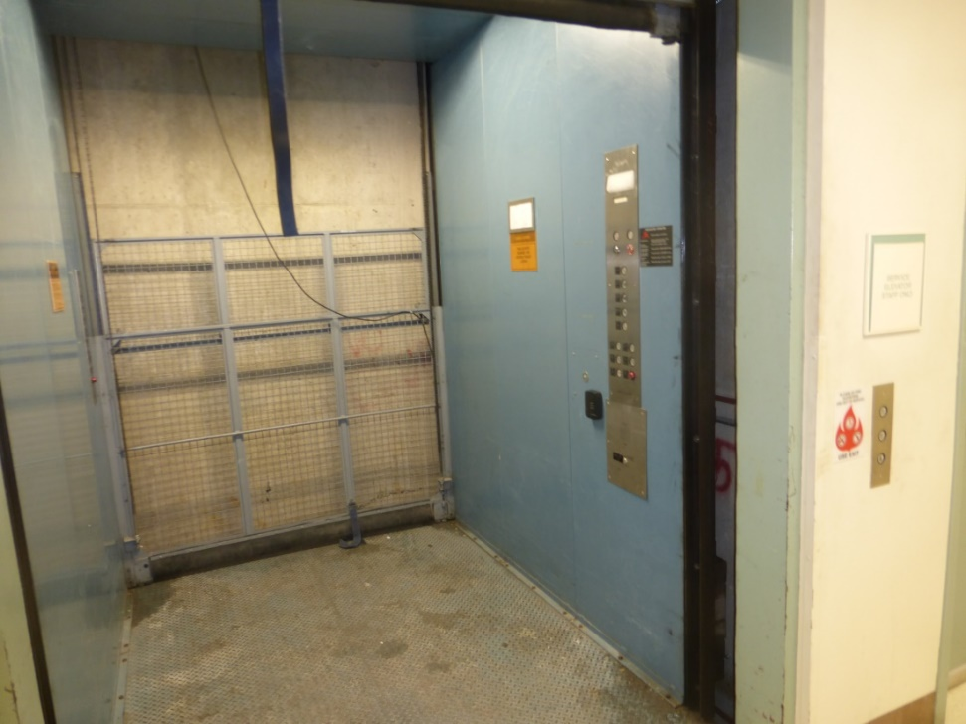
Elevator Renovations
Priority #20 - $751,789 Eicon / #21 - $1,052,620 NSLA / #38 - $1,626,757 Belrose / #44 - $353,508 Frankie Sue
Elevator retrofits are necessary at the Eicon, NSLA, Belrose and the Frankie Sue
It is necessary to upgrade the safety and control systems and the drive components in the existing elevators to provide a safer and more dependable elevator system
Notes:
This project is priority #20, 21, 38, and 44. The Eicon, Library and Archives, Belrose and Frankie Sue buildings all have elevators that are beyond their useful life expectancy.
The life expectancy of an elevator is 30 years.
The Eicon building has an original elevator from 1959.
These older elevators do not comply with new safety laws that require multiple safety systems and do not comply with ADA.
Elevators kill an average of 30 and seriously injure approximately 17,000 people every year in the United States.

Slide 16
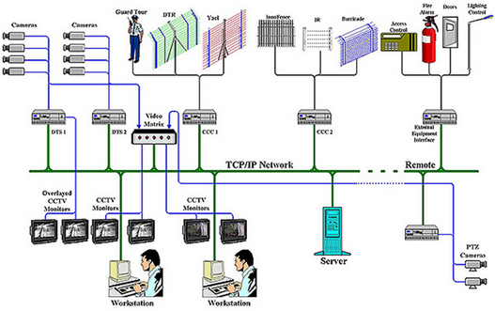
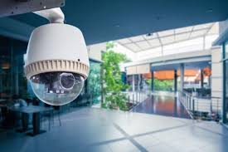
Security System Replacements & Installation
Priority #22 - $1,316,090 Decatur *100% Highway Funds / #39 - $1,112,764 AG’s / #43 - $1,114,505 Supreme Court / #45 - $967,060 NSLA
New Security System Installation at Decatur DMV
100% funded with highway funds
Increased crime requires upgraded security measures
Replacement at Governor’s Mansion, Attorney General’s, and the Supreme Court – Analog system
An upgraded camera system will provide improved coverage and images for Capitol Police
Notes:
The Decatur DMV is project #22 and is *100% Highway funded and will install a new camera system.
Priority #37 the Attorney General’s and #43 Supreme Court will replace existing security systems.
Decatur DMV needs a security system as there have been several attempts to break into the building.
The Attorney General’s and Supreme Court has security systems that are analog and are obsolete and we cannot get replacement parts.
It is important for the life safety and security of state assets, elected officials,
state employees and the public that all systems be replaced with a digital system.

Slide 17
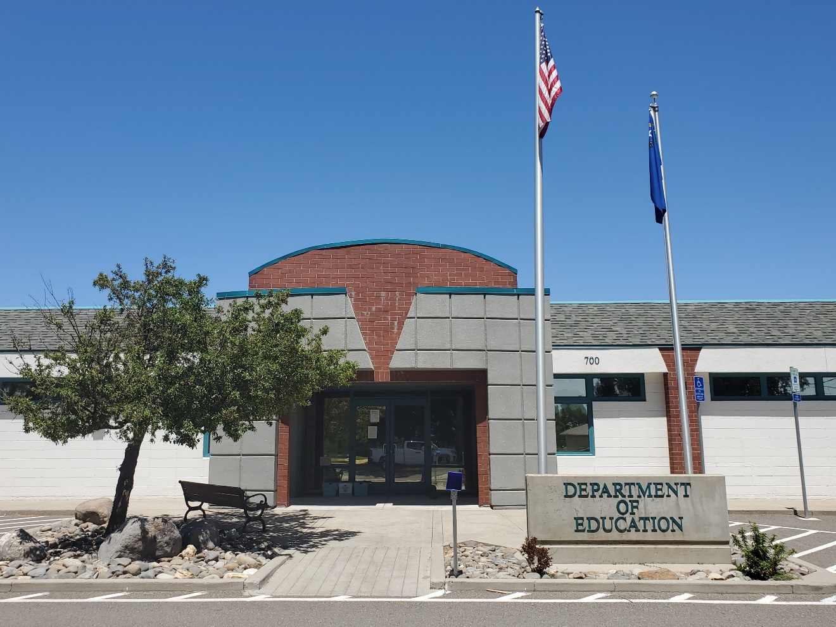
Education Network System Upgrades
Priority # 23 - $787,476
The Building has Cat 3 internet cable with speeds of 10mbs
most State buildings have Cat 5 with speeds at 1,000mbs
Notes:
This project is priority #23 and includes upgrades to the internet and phone system at the Education building.
Currently, the building has Cat 3 cable with a slow internet speed of 10 mega bits per second. This project is proposing the install of Cat 5 with internet speeds of up to 1,000 mega bits per second.
This project would dramatically improve the efficiency of the Education staff.

Slide 18
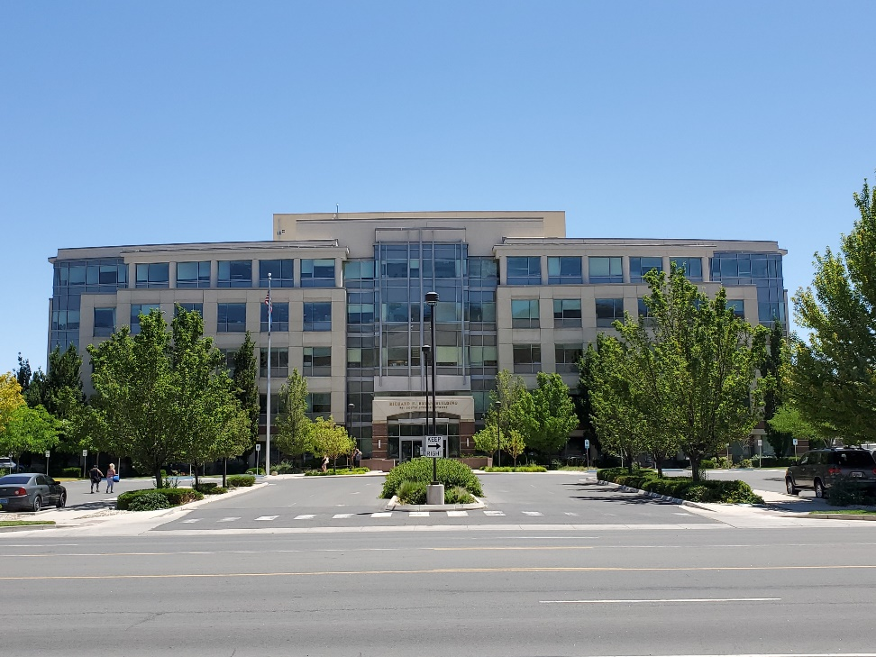
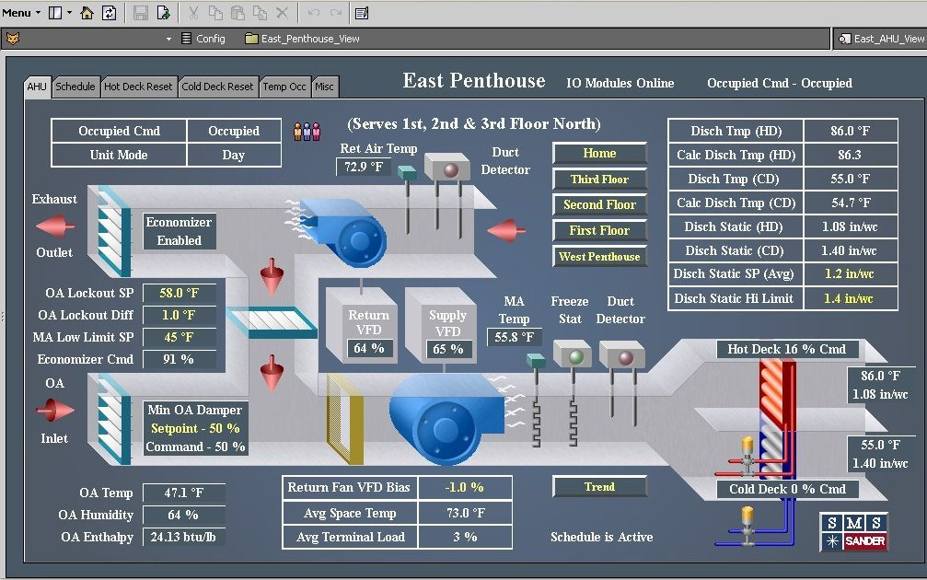
Bryan Building UPS & DDC
Priority #24 - $1,645,621
When the Uninterruptible Power Supply (UPS) fails, the Bryan building loses their security, servers and webpages
The Direct Digital Control (DDC) is 15 years old and beyond its useful life expectancy
Notes:
Priority #24 is to replace the UPS and DDC systems at the Bryan Building.
The UPS has had numerous problems over the last two years, to include bad circuit boards, failure of the back-up batteries, and completely shutting down.
When the UPS shuts down, the building occupants lose their internet and security systems and the public do not have access to each division’s websites.
The DDC controls the heating and air conditioning in the building.
The DDC system will unexpectantly shut down and this turns off all of the heating and air conditioning within the building.
The DDC computer and software have been running 24/7 for over 15 years and
are so old they no longer will support updates and are unable to run on the states EITS security system.
Both systems are beyond their useful life expectancy.

Slide 19
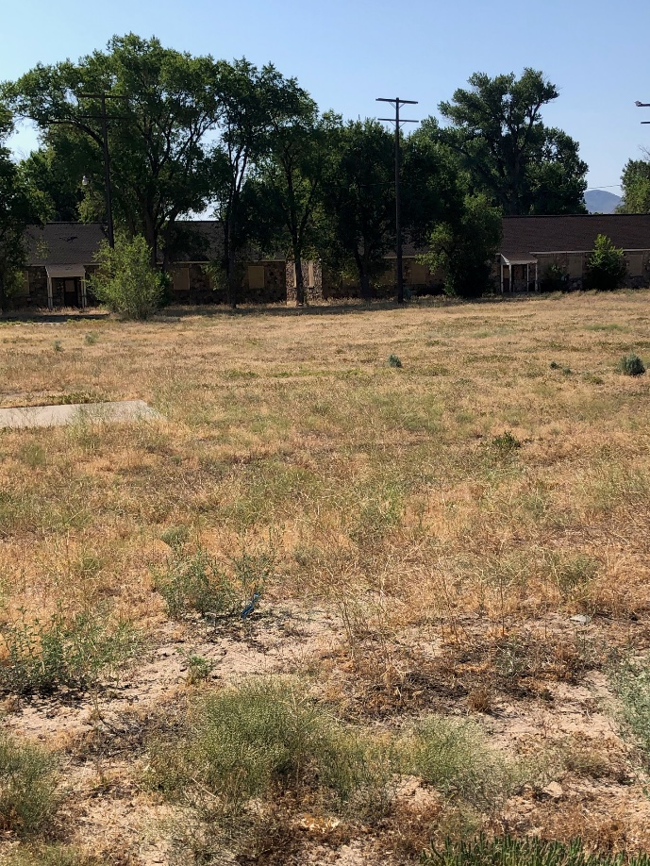
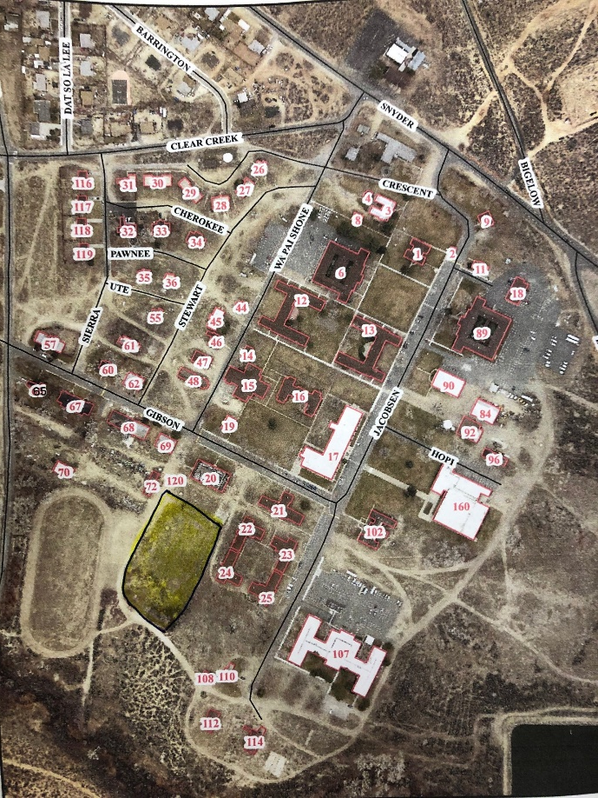
Install Solar Photovoltaic Array
Priority #25 - $411,825 Stewart
Install parking with solar covers at the Grant Sawyer Office Building
Installation of solar at the Stewart Campus
Notes:
This project is priority #25 and proposes to install a new solar field at the Stewart Campus in Carson City.
This project will help the State in achieving the goals set out in Senate Bill 254 and the Governor’s executive order to reduce energy consumption.

Slide 20
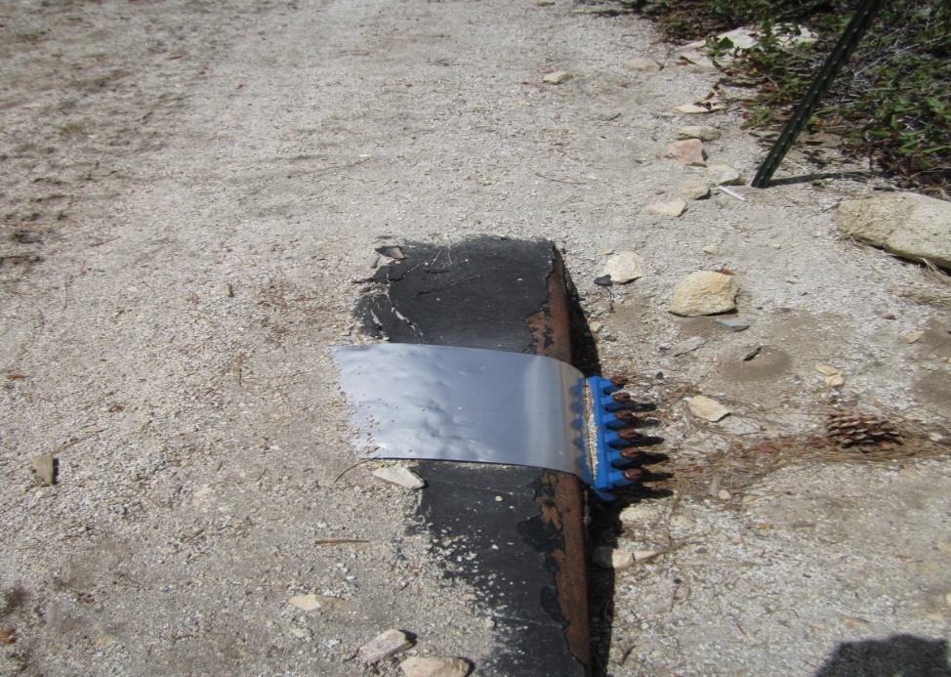
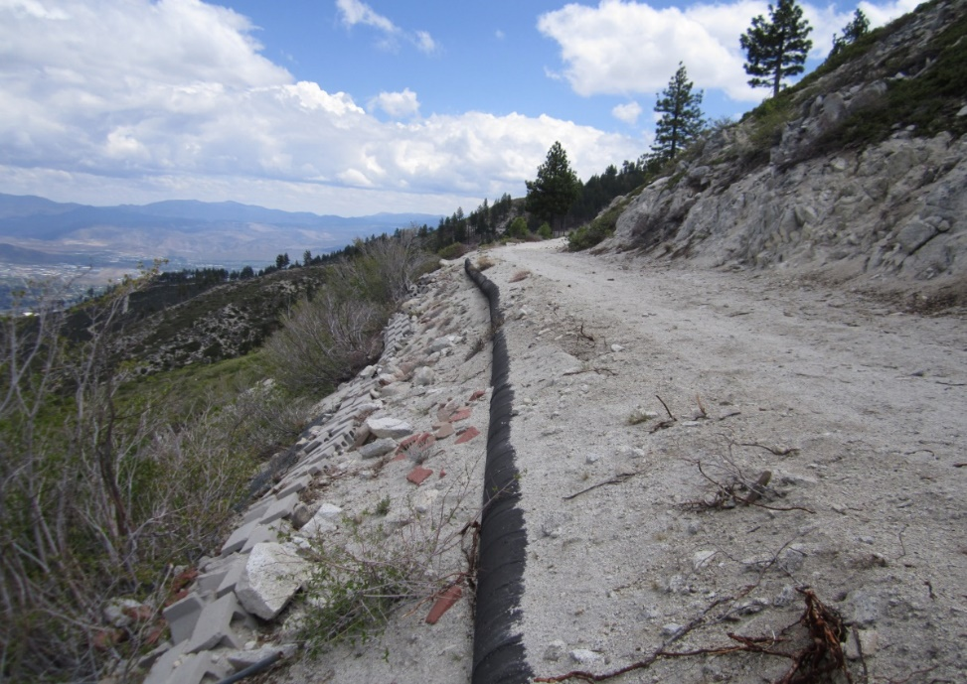
Marlette Water System Transmission Line Replacement
Priority #26 - $1,448,963 Diversion Dam to Saw Mill / #34 - $968,171 East Slope
Replacement of the 18” water transmission main with 24” ductile iron transmission main from the Diversion Dam to the Sawmill site
Part of the water transmission line is sloped and is not structural sound on the side of the hill
The replacement would be approximately 4.6 miles
Notes:
These projects are priority #26 and #34 and propose to replace the water transmission lines.
We have been pressing our luck by using these transmission lines for 70 years.
A typical transmission line has a life expectancy of 50 years.
This transmission line is leaking in numerous locations.
The picture on the left shows a section that is damaged and
has a leak band over it, however it is still leaking.
The picture on the right shows a transmission line on the side of a hill that is not structurally sound.
Currently, the lines are 18” and we are proposing to upsize to 24”.
By upsizing the lines we will be able to sell more water.
In return this will assist with Marlette Lake Water system staying solvent.

Slide 21
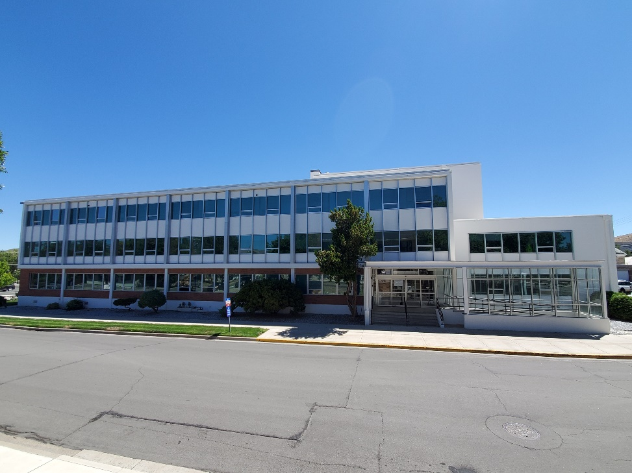
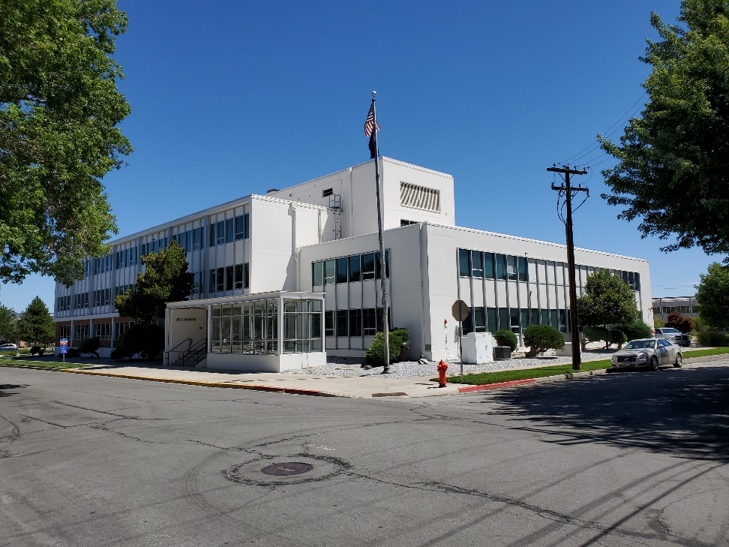
Eicon Window Replacement
Priority #28 - $803,465
1959 single pane windows
Reduce energy consumption
Notes:
This project is priority #28 and is to replace the windows at the Eicon building.
The windows are original to the building dating back to 1959 they are not energy efficient. By replacing the windows it will help the State in achieving the goals set out in Senate Bill 254 and the Governor’s executive order to reduce energy consumption.

Slide 22
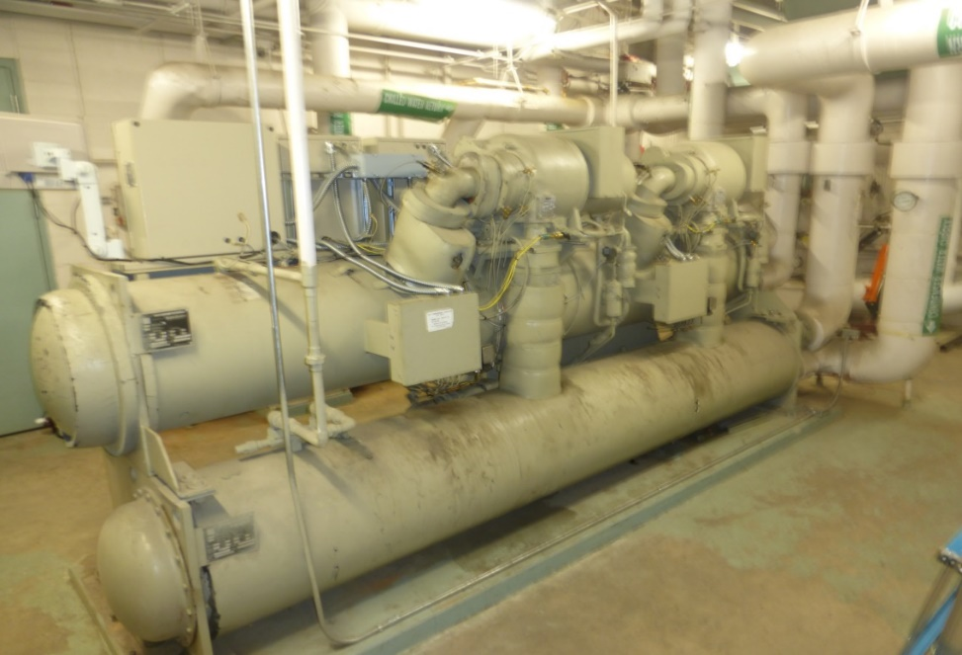
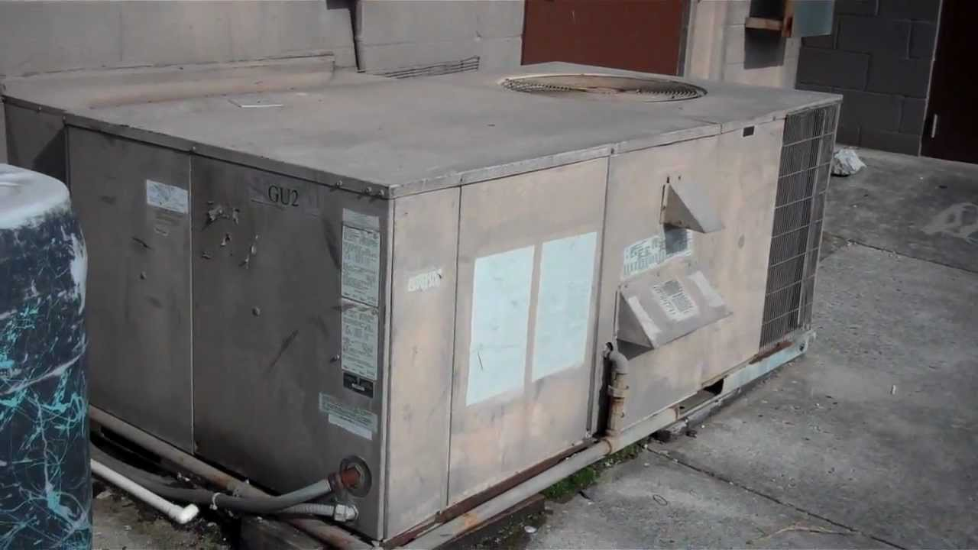
HVAC Equipment Replacement
Priority #29 - $868,598 Stewart 89 / #30 - $749,273 Stewart 107 / #31 - $467,930 Mail Services
All the equipment is very problematic and beyond its useful life expectancy
R22 refrigerant phased out / no longer EPA compliant and no longer sold in the U.S. as January 2020
The Manufacturer Warranty expired at 20-years on the heat exchangers
Approximately, 1000 people die every year in the US from CO poisoning.
Notes:
This project is Priority #29, 30 and 31 and proposes for the HVAC equipment at the Stewart Buildings 89 and 107 and at the Mail Services Building to be replaced.
All the equipment is beyond its useful life expectancy,
is very problematic and uses R22 that has been phased out.
Additionally, by changing these HVAC systems it will help the State in achieving the goals set out in Senate Bill 254 and the Governor’s executive order to reduce energy consumption.

Slide 23
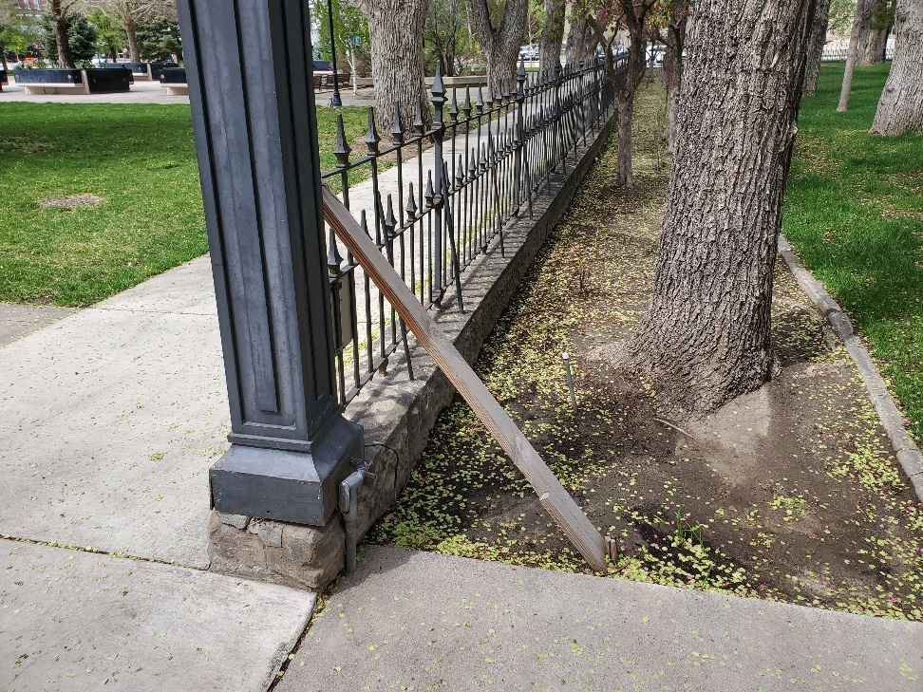
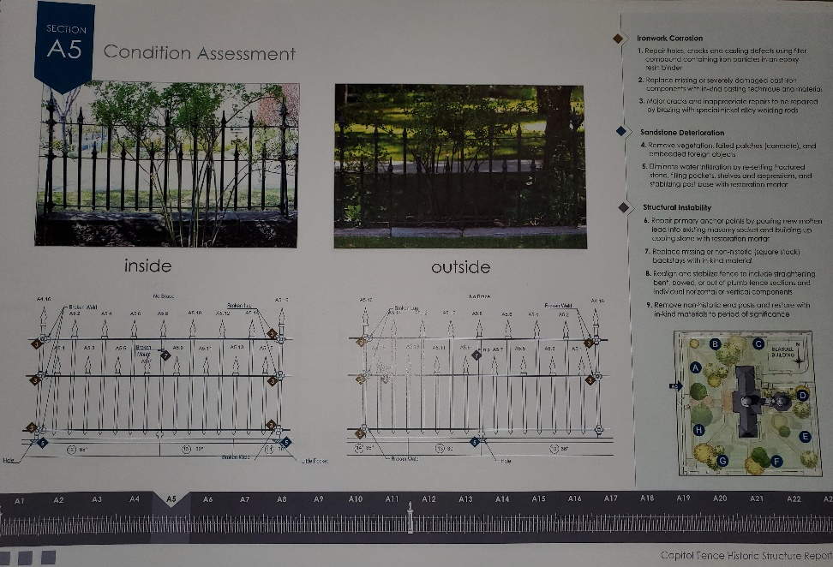
Restore Historical Fence Capitol
Priority #32 - $992,723
Constructed in 1875 for $35.00 per section
In 1911 the lights were installed on the corners
In 1980 the fence was refurbished, to include structural, lighting and painting
Needs to be refurbished again to include structural, lighting and painting
Notes:
This project is priority #32 and proposes to refurbish the historical fence at the Capitol.
The fence was Constructed in 1875 and the lights were installed on the corner poles in 1911.
In 1980 there was a refurbishment project to include structural, lighting and paint.
Now in 2020 the fencing needs another refurbishment project to include structural as the welds on the fence from 1875 are breaking.
The picture on the left shows the fence anchored in the sandstone blocks,
which is cracking and is no longer structurally sound.
The electrical will need to be repaired and the fence will also be painted.

Slide 24
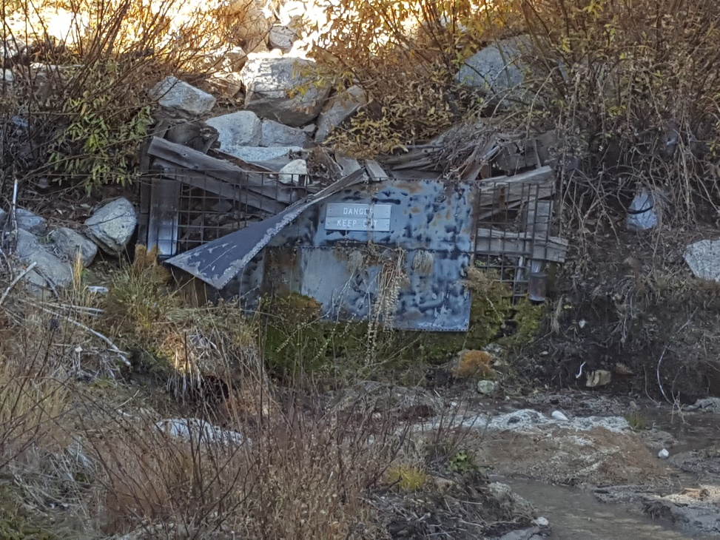
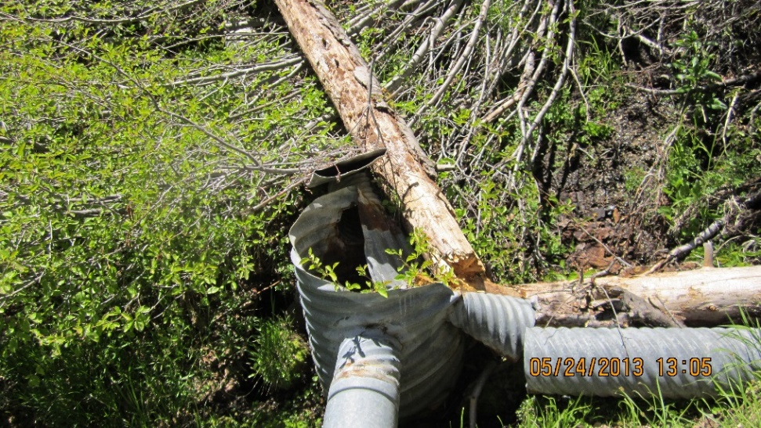
Marlette Lake East Slope Catchments
Priority #34 - $968,171
The project includes vegetation clearing, grading, installation of precast concrete structures, piping connections and reconstruction of the historic timber tunnel entrance to the Tunnel Portal
Construct three additional surface water catchment basins (Catchments No. 1, No. 2 and Tunnel Catchment)
Notes:
This project is priority #34 and will construct 2 new catchments and will reconstruct the historic timber tunnel on East Slope.
The new catchments will be able to collect additional water from east slope and in return:
1.) sell water without having to pump it from Marlette as pumping is very costly and east slope is gravity fed.
2.) when collecting the water from the hill it has a natural filtration system and is much cleaner than Marlette Lake water.

Slide 25
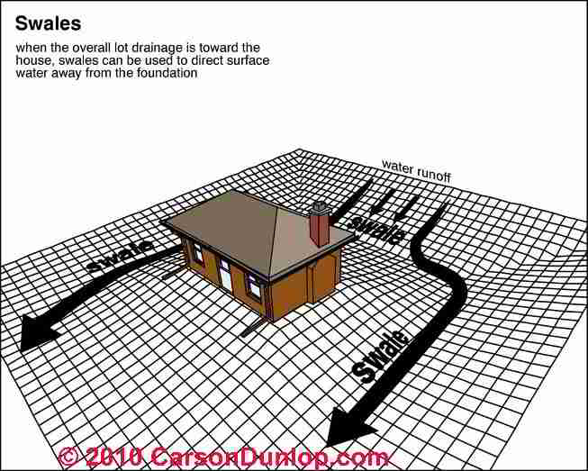
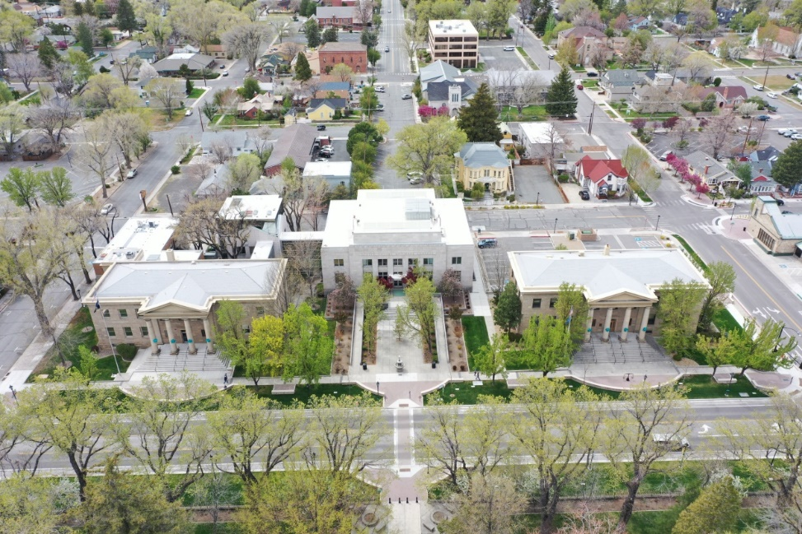
Site Drainage Improvements
Priority #36 - $153,233 Frankie Sue / #37 - $336,585 AG’s / #47 - $491,865 Stewart
This project will provide drainage improvement throughout Frankie Sue, Attorney General’s and Stewart campus
The project scope includes abandonment of existing infiltration drains, installation of a storm drain system and connection of building drains into storm drain piping
Notes:
This Project is priority #36, 37 and 47 and proposes drainage improvements at Frankie Sue, Attorney General’s and the Stewart Campus.
All of the locations do not have adequate drainage.
It is recommended per International Building Code for a 5% slope away from the buildings for 10’.
This project will prevent water infiltration and possible indoor air quality issues.

Slide 26
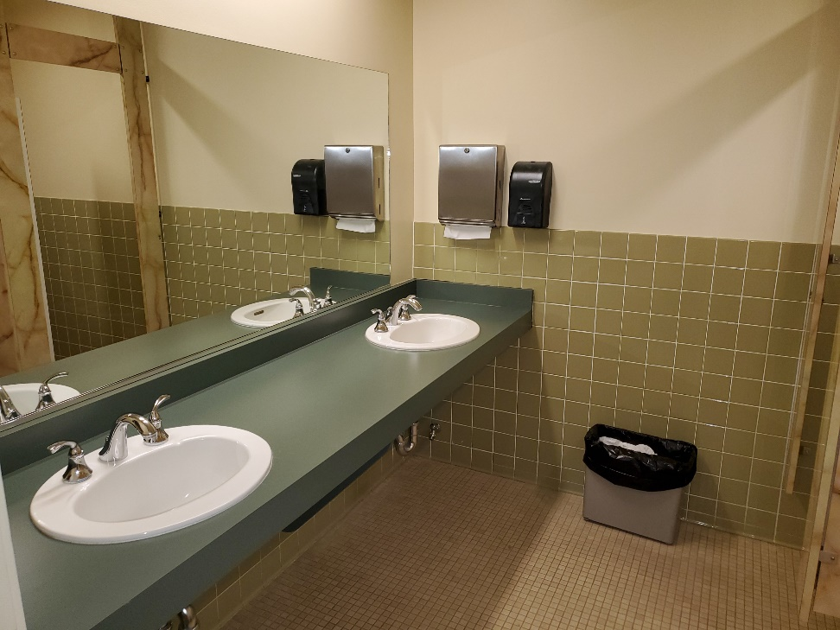
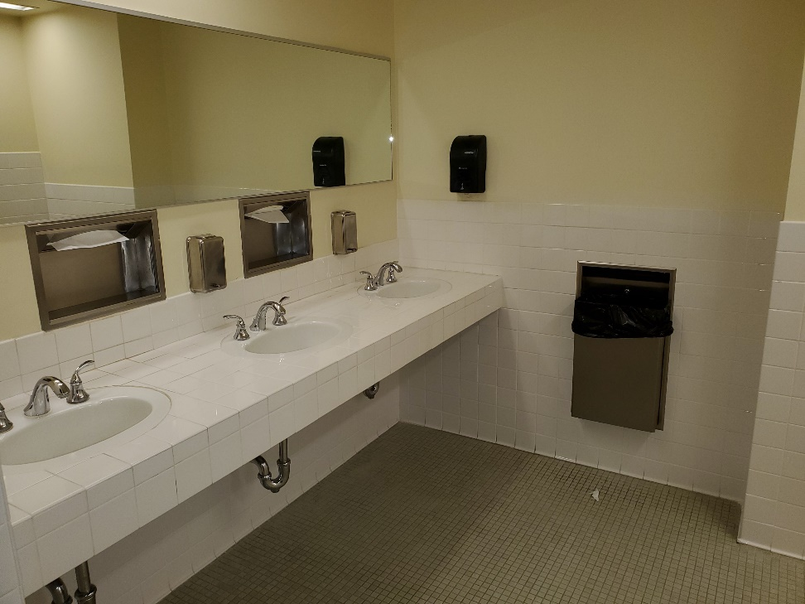
ADA Remodel 2nd Floor Capitol Restrooms
Priority #40 - $712,876
Notes:
Priority #40 proposes to remodel the second floor Capitol restrooms to comply with ADA. The last remodel took place in 1970.

Slide 27
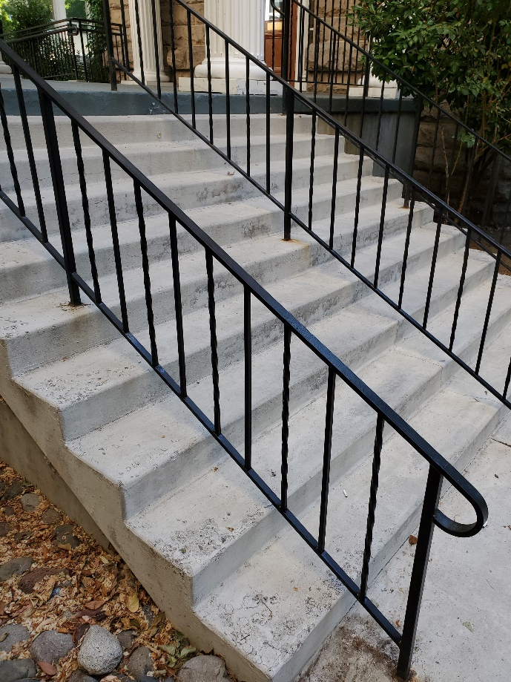
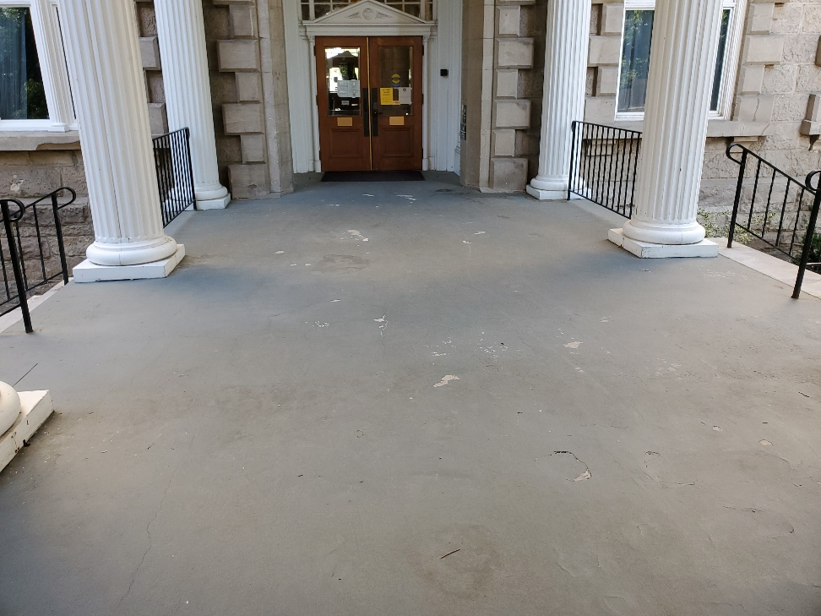
Concrete Breezeway and Stairway Replacement
Priority #41 - $246,154 Capitol
Spalling and cracking concrete breezeway and stairs
Notes:
This project is priority #41 and is to remove and replace the concrete breezeway and stairs at the Capitol Building.

Slide 28
Marlette Lake Office Site Upgrades
Priority #42 - $297,094
Upgrade asphalt, electrical and safety
Install interior and exterior LEDs, security system and a fence around the property with an entry gate
Notes:
This project is priority #42 and would upgrade the Marlette Lake office site.
This would include installing interior and exterior LEDs, a security system,
fencing around the site to include an entry access gate, new asphalt and electrical.

Slide 29
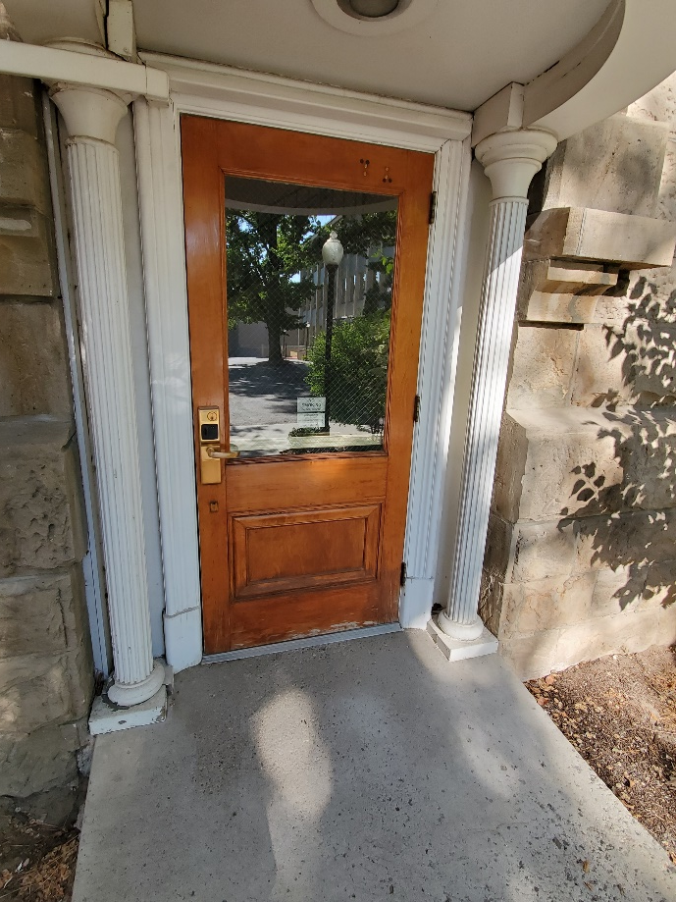

Capitol Door Hardware Replacement
Priority #46 - $534,544
Beyond its useful life expectancy
Not standardized and not ADA compliant
Notes:
This project is priority #46 and it is to replace the door hardware at the Capitol building. This would include the lock sets, hinges, closures, door levers, kick plates, doorstops, and electric door devices and card readers.
This would standardize the door hardware and bring it up to current ADA code.
This door hardware was last replaced in 1977 and is beyond its useful life expectancy.

Slide 30

End of the Presentation. Any Questions?

